Slide 1
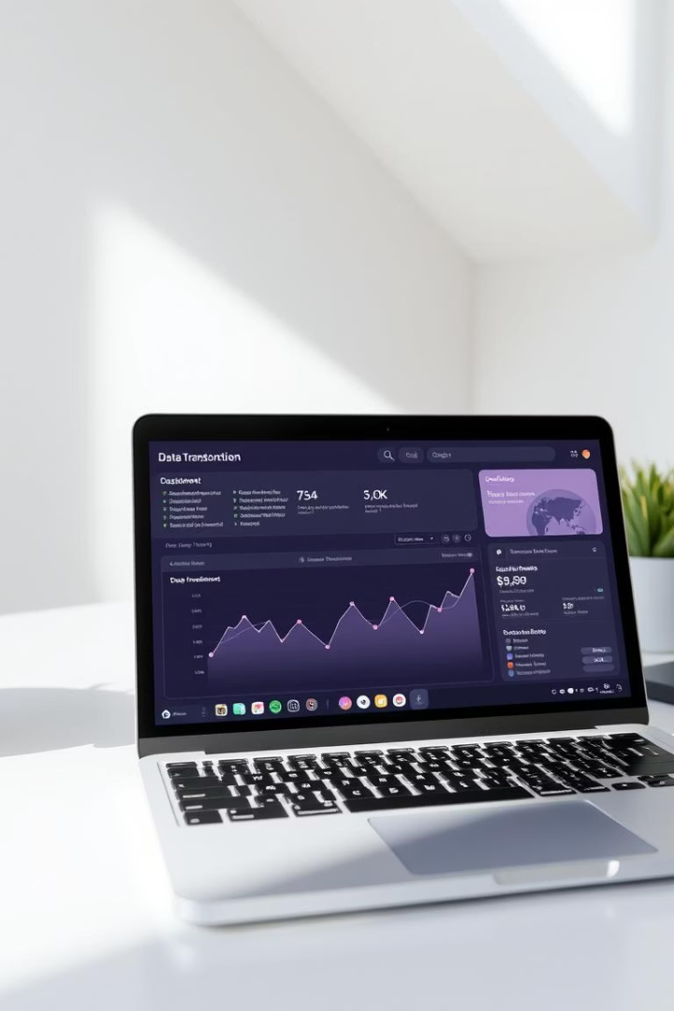
TabulaX: Multi-Class Table Transformation Framework Using Large Language Models
MACHA HARSHITHA 23BD1A6633
N SIDHI 23BD1A6638
MUCHAKURTHI NITHILESH 23BD1A054V
MATETI HARSHAN 23BD1A054G
MATETI HRUSHIKESH 23BD1A663
GANDRA AKHILESH RAO 23BD1A052C
GROUP NO:351

Slide 2
PROBLEM STATEMENT:
Integrating tabular data from diverse sources remains a major challenge due to inconsistencies in formatting, representation, and transformation logic.
Traditional approaches often fail to generalize across varying transformation types or lack interpretability in the generated outputs.
This process is:
* Time-consuming
* Not scalable
* Hard to maintain
There is a pressing need for an automated system that can not only classify diverse transformation patterns in tabular data but also generate accurate and human-readable transformation functions.
This system should be capable of handling complex multi-class transformations—such as string manipulation, numerical computation, and algorithmic logic—while maintaining high accuracy and explainability to support data integration and downstream analysis tasks.

Slide 3
Solution: TabulaX – Classification & Transformation Using Mistral
1. Classification Module
The classifier takes pairs of source and target values and uses in-context learning to
determine the transformation type.Classifies column transformations into 4 categories:
String-based: Text formatting, merging e.g., “John” + “Doe” → “John Doe”
Numeric: Arithmetic or scaling e.g., (F − 32) × 5/9 → °C
Algorithmic: Conditional logic e.g., IF score > 50 → “Pass” ELSE “Fail”
General: Mixed/multi-step logic e.g., “Paris” → “FR” (via geo-mapping)
2. Transformation Module
Uses few-shot prompting with Mistral to generate:
Accurate, human-readable transformation code
Outputs in Python, formulas, or logic expressions
Ensures explainability, customizability, and local deployment

Slide 4
Types of Table Transformations in TabulaX
1.String
3.Alogrithmic
Requires conditional logic or rule-based operations
Examples: IF statements, date calculations, categorization
🧩 Best suited for LLMs like Mistral due to reasoning
E.g., Age > 18 → “Adult”, else “Minor”
Involves operations on text columns
Examples: concatenation, casing, trimming
🧠 LLMs help interpret naming patterns and string rules
E.g., “John” + “Smith” → “John Smith”
2.Numeric
4.General
•Simple arithmetic or unit conversions
•Examples: scaling, offsets, percentage changes
•⚙️ Often handled without LLMs for speed & accuracy
•E.g., Inches × 2.54 → Centimeters
In numeric transformations we use Levenberg–Marquardt Algorithm which is an optimisation algorithm which is performed on various non linear functions and calculates the mean
squared error Which ever function has the least mscis shown as the output.
Complex, multi-step, or mixed-type logic
Examples: geo-mapping, combining string + numeric logic
🌐 Needs flexible reasoning and external knowledge
E.g., “New York” → “US”

Slide 5
💼 Business Scope of TabulaX
🔍 What Problem We Solve
•Manual data transformation is slow, error-prone, and requires coding skills.
🚀 What We Offer
•AI-powered platform for automated, explainable table transformations
•Supports string, numeric, algorithmic, and general transformations
•Built on Mistral LLM for local, cost-efficient deployment
🎯 Target Users
•Enterprises, SaaS platforms, data teams, government, and education sectors
💰 Monetization
•B2B Licensing • SaaS Subscriptions • API Access • Custom Services
📈 Market Opportunity
•Growing demand for no-code data tools
•Rise of LLM-based enterprise automation

Slide 6
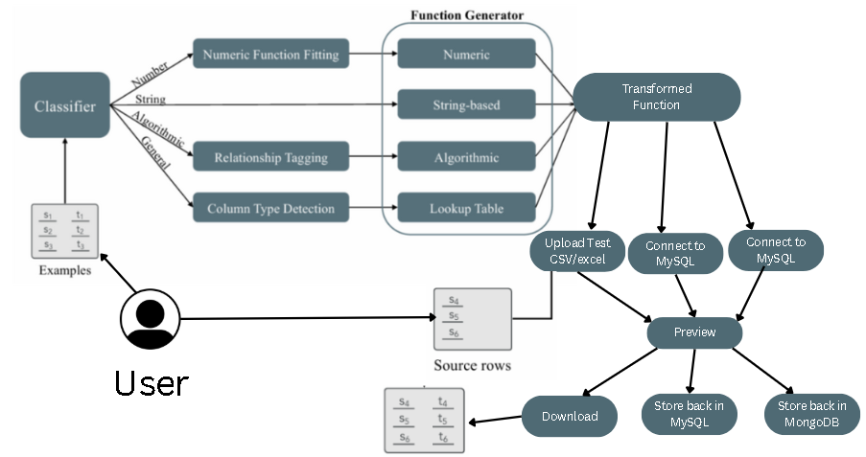
Architecture Evolution
The architecture illustrates a modular system where a Classifier first categorizes transformation examples into four types: Numeric, String-based, Algorithmic, or General. Each category is routed through specialized Function Generator components (e.g., numeric fitting, relationship tagging, etc.) to generate interpretable Transformation Functions. These functions are then applied to source data rows to support Downstream Tasks such as data integration.

Slide 7
Real-Life Users of TabulaX
📊 Data Integration from Heterogeneous Sources
• Standardize columns from merged datasets (e.g., CRM + ERP systems)
• Handle inconsistent naming, date formats, or units
📥 User-Submitted Form or Survey Data
• Clean up free-text entries (e.g., name formatting, phone normalization)
• Validate and categorize responses using logic
🧾 Financial and Log Data Transformation
• Apply currency/unit conversions or derive financial indicators
• Automate tagging of transactions based on description patterns
🌍 Geospatial and Demographic Mapping
• Convert city/state names to country codes
• Derive regions or zones based on postal codes
📆 Date & Time Processing
• Convert timestamps, calculate age or durations
• Normalize formats across systems (e.g., ISO → local)
🧠 No-Code/Low-Code Data Cleaning Tools
• Empower non-technical users to define transformations via examples
• Show human-readable logic for transparency and trust

Slide 8
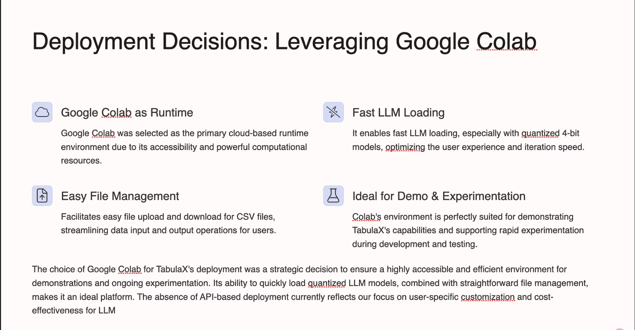

Slide 9
SOFTWARE REQUIREMENTS
✅ Functional:
* File upload and column selection
* LLM classification and transformation
* Preview + download transformed data
* DB connection (Mongo/MySQL)
⚙ Non-Functional:
* Cross-browser UI
* Prompt safety and validation
* Fast feedback loop (<5 sec)
* Modular backend service

Slide 10
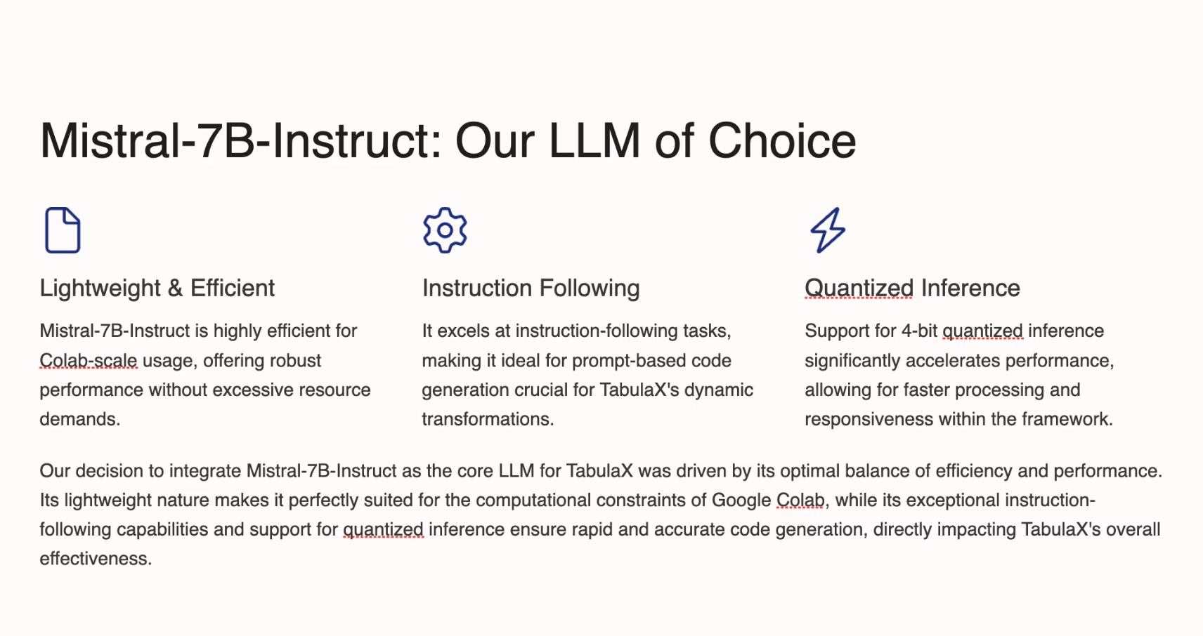

Slide 11
Tech Stack
* Frontend: React, Tailwind CSS
*Backend: Node.js + Express
*LLM Host: Python + Flask on Colab (Mistral 7B)
*Database: MongoDB (Auth, file tracking)
*Deployment: ngrok (temporary), planned API hosting

Slide 12
Database Design
* Users: name, email, password
* Transformations: user_id, file_ids, type, function_code, timestamp
* MongoDB is used for storing metadata and optional transformed outputs
Challenges Faced
* Getting LLMs to produce only function code (no explanation)
* Handling datetime transformations (chain-of-thought prompting)
* Making execution safe (exec() sandboxing)
* Formatting diversity in CSVs
* Inconsistent LLM outputs (prompt engineering fixes)

Slide 13
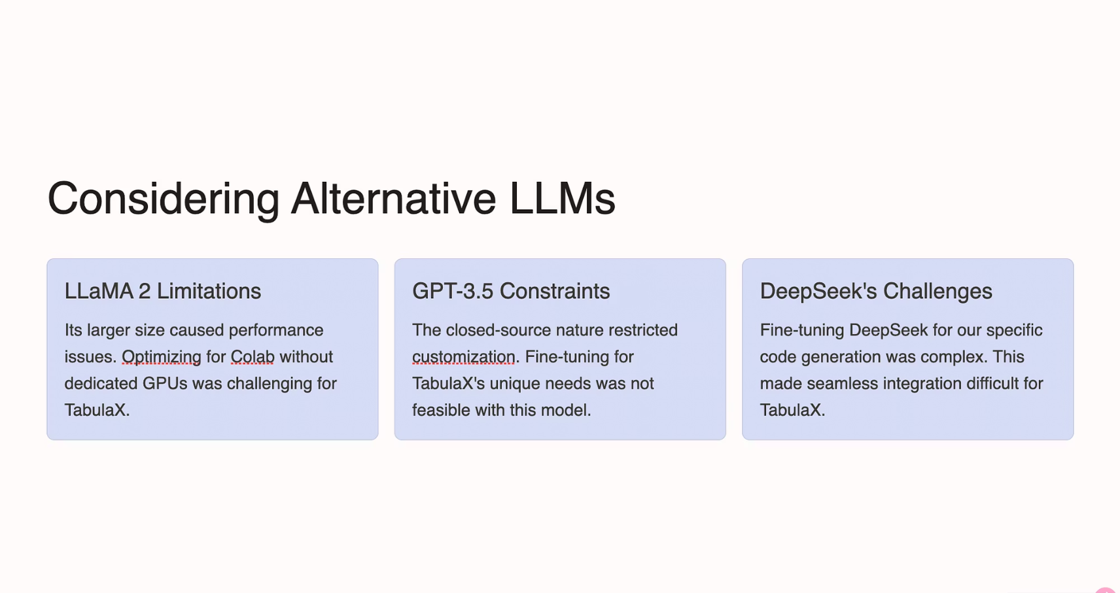

Slide 14
Conclusion:
TabulaX addresses a key challenge in data preparation: automating and explaining
diverse table transformations.
By combining Mistral LLM with a smart classification pipeline, it supports:
Accurate transformation across string, numeric, algorithmic, and general types
Human-readable, editable logic for transparency and trust
Local deployment, making it accessible and cost-effective
Our system empowers users—from analysts to non-coders—to transform data faster, smarter, and with confidence.

Slide 15
Future Enhancements
* Enable user overrides and editing of generated code
* Add error metrics (like accuracy or mismatch rate)
* Support join/deduplication logic (next level integration)
* Host LLM as an API instead of ngrok
* UI enhancements (history, undo, log view)

Slide 16
Thank You!!

